Slide 1
university
Microstrip Antenna
Supervised by :
Dr. Sherif HEKAL
Presented by:
Eng. Ramez hosny
eng. fady emad

Slide 2
Outlines :
Micro-Strip Antennas
Introduction .
Microstrip Antennas Types .
Microstrip Antennas Shapes .
Types of Substrates(Dielectric Media).
Comparison of various types of flat profile printed antennas .
Advantages & DisAdvantages of MSAs .
Applications of MSAs .
Radiation patterns of MSAs .
How to Optimizing the Substrate Properties for Increased Bandwidth ?
Comparing the different feed techniques .
Design Of Microstrip

Slide 3
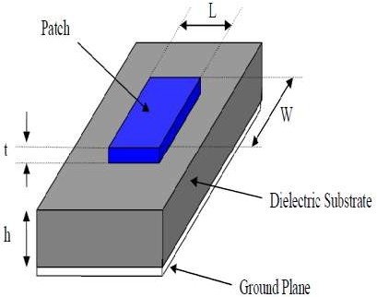
Introduction
In its most basic form, a Microstrip patch antenna consists of a radiating patch on one side of a dielectric substrate which has a ground plane on the other side
For good antenna performance, a thick dielectric substrate having a low dielectric constant is desirable since this provides better efficiency, larger bandwidth and better radiation .
In genaral Micro strip antennas are also known as “ PATCH ANTENNAS ”.
These are mostly used at microwave frequencies.
Because the size of the antenna is directly
tied the wavelength at the resonant frequency.
Micro strip patch antenna or patch antenna is a narrowband width antenna.
Structure of a Microstrip Patch Antenna

Slide 4
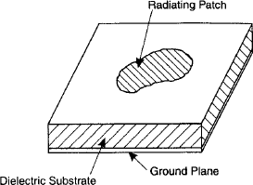
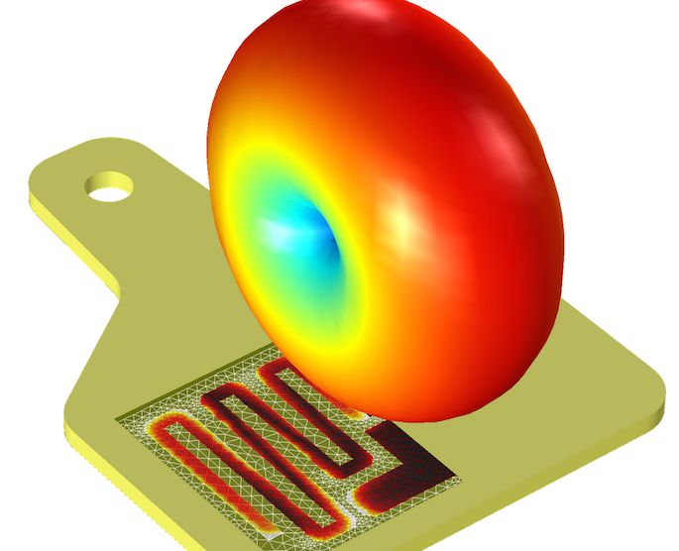
Micro strip antennas are easy to fabricate and comfortable on curved surface .
The directivity is fairly insensitive to the substrate thickness.
Micro strip patch antennas patches are in variety of shapes ,
such as rectangular , square , triangular and circulator …etc.
Patch antenna

Slide 5
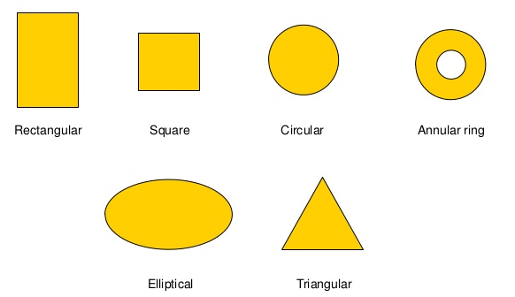
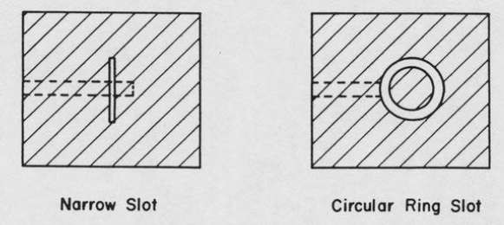
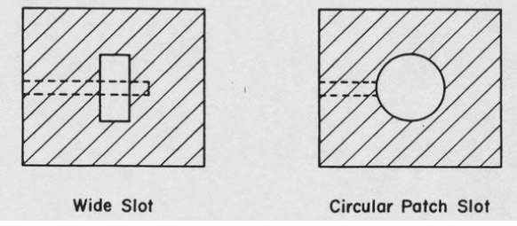
Microstrip Antennas Shapes
a) Single radiating patches
b) Single slot radiator

Slide 6
Substrates are:
Types of Substrates(Dielectric Media)
The most commonly used substrates are,
Honey comb(dielectric constant=1.07) 2)Duroid(dielectric constant=2.32) 3)Quartz(dielectric constant=3.8) 4)Alumina(dielectric constant=10)
A thicker substrate will increase the radiation power
, reduce conductor loss and improve Band width.

Slide 7
Comparison of various types of flat profile antennas:
Charaterstics | Microstrip patch antenna | Microstrip slot antenna
Profile | Thin | Thin
Fabrication | Very easy | Easy
Polarization | Both linear& circular | Both linear& circular
Dual freq operation | Possible | Possible
Shape | Any shape | Rec &circle

Slide 8
Advantages
Low fabrication cost, hence can be manufactured in large quantities.
Easily integrated with microwave integrated circuits (MICs).
Capable of dual and triple frequency operations.
Supports both, linear as well as circular polarization.
Low cost , Less size , Low Mass .
Mechanically robust when mounted on rigid surfaces.
High Performance
Light weight and low volume.

Slide 9
Disadvantages
Narrow bandwidth associated with tolerence problem
Lower Gain(Nearly 6db( .
Spurious feed radiation (surface waves, Feed strips, etc.)
Most microstrip antennas radiate into half-space .
Relatively low efficiency (due to dielectric and conductor losses) .
low impedance bandwidth.
Extraneous radiation from feeds and junctions .
Low power handling capacity.

Slide 10
Solution :
Low power and low gain can overcome by arrays configuration.
Surface wave associated limitations such as poor efficiency,increased mutual coupling
, reduced gain and radiation pattern can overcome.
The band width can increase up to 60% by using some special techniques.

Slide 11
Applications
Used in mobile satellite communication system.
Direct broad cast television (DBS).
Wire less LAN’S.
Feed elements in coaxial system
GPS system.
Missiles and telementry
UHF Patch Antennas for Space

Slide 12
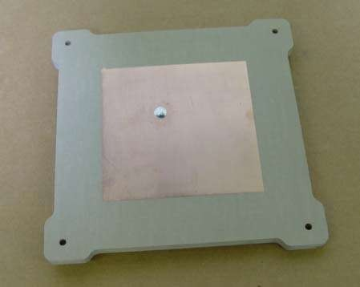
UHF Patch Antennas for Space
Antenna Development Corporation, Inc.(AntDevCo) employees have designed and manufactured spacecraft microstrip patch antennas for many small spacecraft programs.
These antennas are capable of supporting high data rates to at least 10 Watts of transmitted power.
Applications include GPS, NASA SN (Including TDRSS forward/return pairs), radar
transponder,
The antennas can be supplied with LHCP, RHCP, or
linear polarization .
Some Of Application:
UHF Patch antenna

Slide 13
Why we use Microstrip Patch Antennas ?
Used for some reasons:
Flat surface makes them ideal for mounting on airplane
Impedance matching fairly simple
Microstrip patch antennas have a very high antenna quality factor(Q).
Notes:
Q represents the losses associated with the antenna and a large Q leads to narrow bandwidth and low efficiency.
Q can be reduced by increasing the thickness of the dielectric substrate. But as the thickness
increases, an increasing fraction of the total power delivered by the source goes into a surface
wave

Slide 14
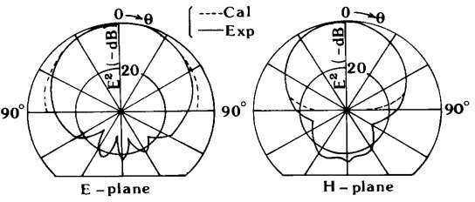
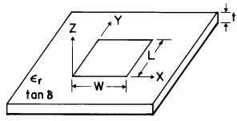
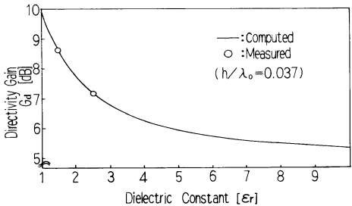
Radiation patterns of a rectangular microstrip patch antenna
Radiation patterns of MSAs .
The directivity of a microstrip antenna as a function of dielectric constant computed :-

Slide 15
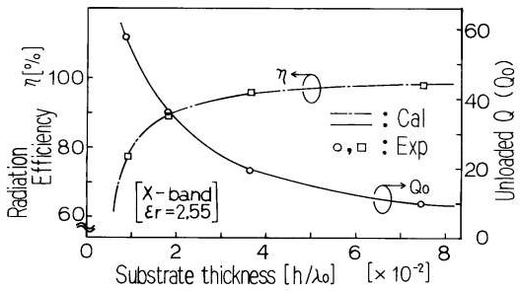
Radiation efficiency, h, and unloaded radiation Q, Q o, as a function of substrate thickness .
Figure shows that :A microstrip patch that uses a thicker substrate is more efficient.
In addition, as the substrate thickness increases, the radiation Q of the antenna decreases.
Thus, impedance bandwidth increases with increasing substrate thickness.

Slide 16
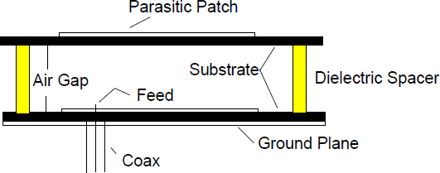
Optimizing the Substrate Properties for Increased Bandwidth
The easiest way to increase the bandwidth of an MSA is to :
1) Print the antenna on a thicker substrate.
2) Decrease the dielectric constant of the substrate.
3) Stack two patches on top of each other separated by a dielectric substrate or spacers.
A stacked circular patch EMC-MSA fed using a coaxial probe.
Notes:
1-However, thick substrates tend to trap surface wave modes , especially if the dielectric constant of the substrate is high .
Finally if the substrate is very thick, radiating modes higher than the fundamental will be excited.
2- However, this has detrimental effects on antenna size reduction since the resonant length of an MSA is shorter for higher substrate dielectric constant..
In addition, the directivity of the MSA depends on the dielectric constant of the substrate
3-The application involved two identical circular patches stacked on top of each other. The lower patch was fed using a coaxial probe feed, and the top patch was electromagnetically coupled to the lower one .

Slide 17
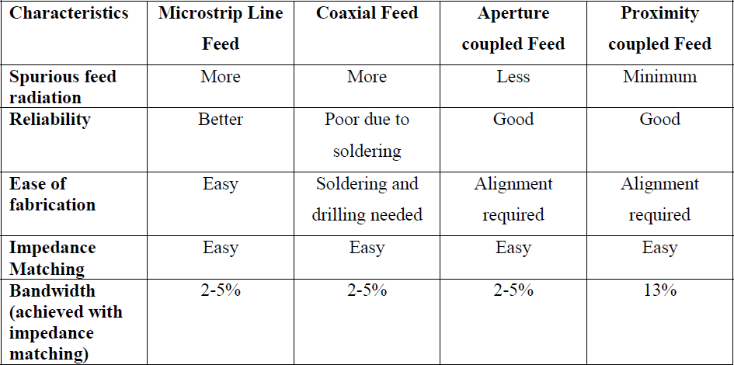
Comparing the different feed techniques :-

Slide 18
Feeding Techniques:
Coaxial feed
Microstrip feed
Proximity coupled microstrip feed
Aperture coupled microstrip feed
Line Feed

Slide 19
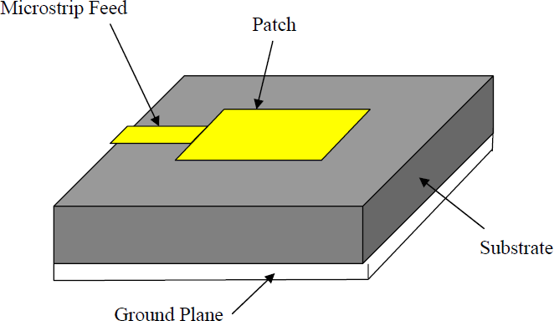
1-Microstrip Line Feed :
In this type of feed technique, a conducting strip is connected directly to the edge of the microstrip patch.
This kind of feed arrangement has the advantage that the feed can be etched on the same substrate to provide a planar structure.

Slide 20
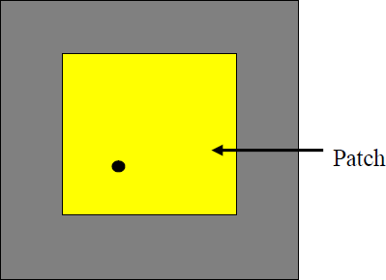
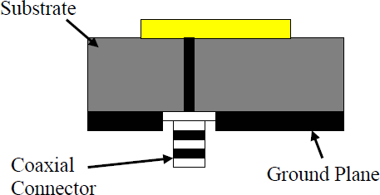
-2- Coaxial Feed :-
The Coaxial feed or probe feed is a very common
technique used for feeding Microstrip
patch antennas.
The main advantage of this type of feeding scheme is that the feed can be placed at any desired location inside the patch in order to match with its input impedance.
This feed method is easy to fabricate and has low spurious radiation.
Probe fed Rectangular Microstrip Patch Antenna from top
However, its major disadvantage is that it Coaxial Ground Plane Connector Substrate Patch provides narrow bandwidth and is difficult to model since a hole has to be drilled in the substrate . and the connector protrudes outside the ground plane, thus not making it completely planar for thick substrates .
Probe fed Rectangular Microstrip Patch Antenna from side view

Slide 21
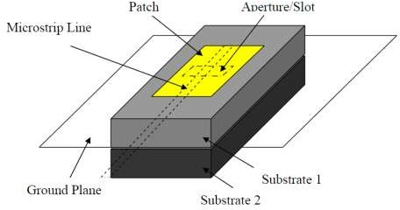
3--Aperture Coupled Feed
In this type of feed technique, the radiating patch and the microstrip feed line are separated by the ground plane .
Coupling between the patch and the feed line is made through a slot or an aperture in the ground plane.
Aperture-coupled feed
The coupling aperture is usually centered under the patch, leading to lower cross polarization due to symmetry of the configuration.
The amount of coupling from the feed line to the patch is determined by the shape, size and location of the aperture.

Slide 22
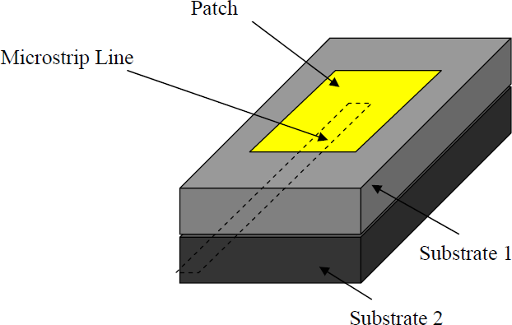
4--Proximity Coupled Feed
This type of feed technique is also called as “the electromagnetic coupling scheme” .
Proximity-coupled Feed
Two dielectric substrates are used such that the feed line is between the two substrates and the radiating patch is on top of the upper substrate.
The main advantage of this feed technique is that it eliminates spurious feed radiation and provides very high bandwidth due to overall increase in the thickness of the microstrip patch antenna.
This scheme also provides choices between two different dielectric media, one for the patch
and one for the feed line to optimize the individual performances.
Matching can be achieved by controlling the length of the feed line and the width-to-line ratio
of the patch.
The major disadvantage of this feed scheme is that it is difficult to fabricate because of the two dielectric layers which need proper alignment.
Also, there is an increase in the overall thickness of the antenna.

Slide 23
Design Of Microstrip :
Where :

Slide 24
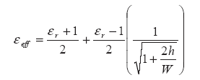
Design Of Microstrip :

Slide 25
Design Of Microstrip :

Slide 26
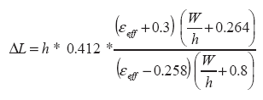
Design Of Microstrip :
The length “ L “:

